Slide 1
SENTIMENTAL ANALYSIS In Social Server
TEAM – BiCREW

Slide 2
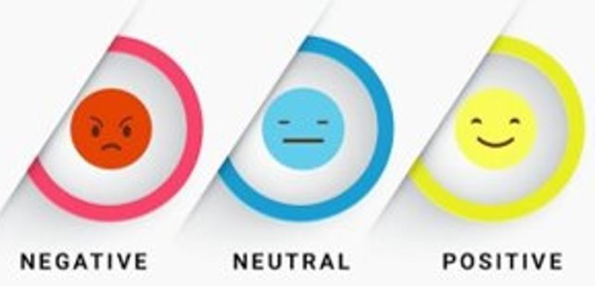
What is Sentiment Analysis ?
Sentiment Analysis is the process of classifying whether a block of text is positive, negative, or, neutral from Vader Lexicon and we tried calculate the score of each sentiments

Slide 3

What is Vader Lexicon ?
VADER (Valence Aware Dictionary and sEntiment Reasoner) is a lexicon and rule-based sentiment analysis tool that is specifically attuned to sentiments expressed in social media

Slide 4
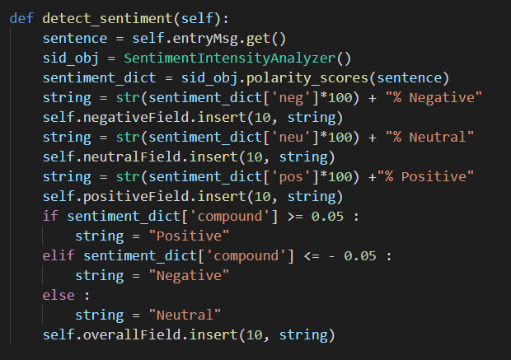
Code

Slide 5
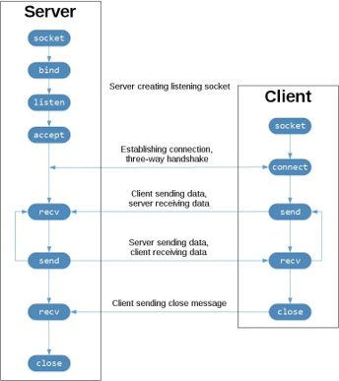
Server
and Client Architecture

Slide 6
Prototype

Slide 7
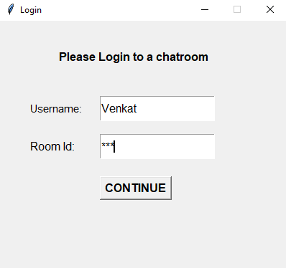
Login
Screen

Slide 8
Platform

Slide 9
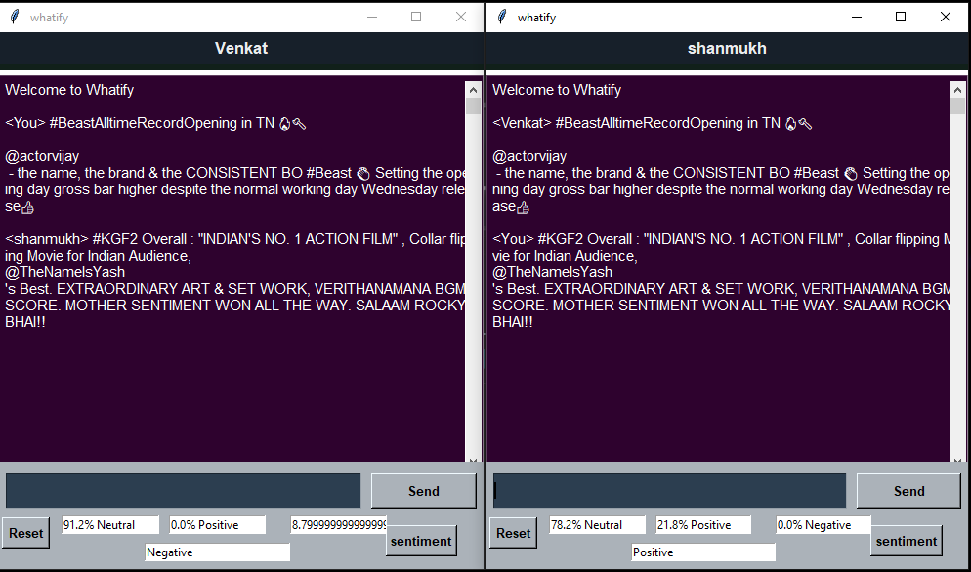

Slide 10


Thank You
Venkatakrishnan R - 20078
M.Phani Shanmukh - 20040

